Slide 1
AMBA APB 3 PROTOCOL
By Md Shakil Ansari
Kasura Technologies Pvt Ltd.

Slide 2
CONTENTS
Introduction to AMBA 3 APB
Salient features
What's new into APB v1.0
AMBA 3 APB Signals
Operating States
Transfer Mechanism of APB
Error Response
Conclusion

Slide 3
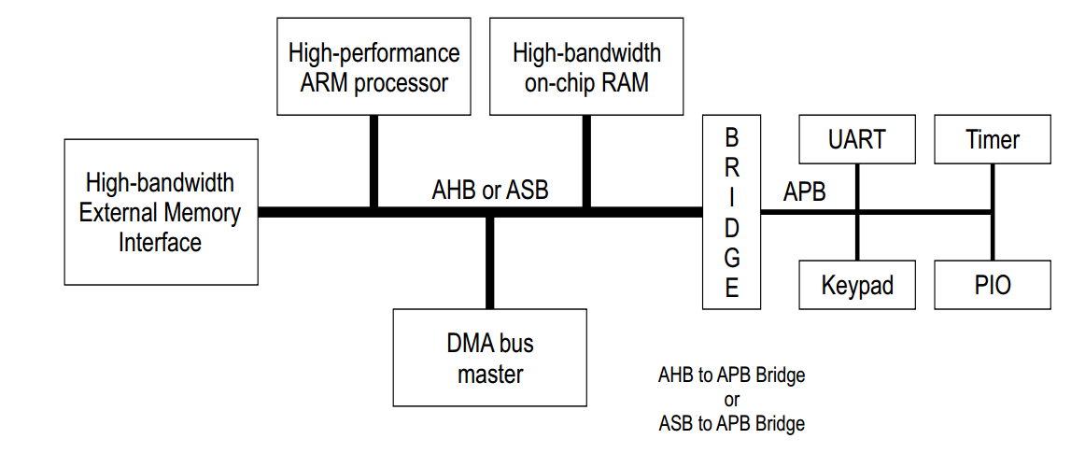
Introduction to AMBA 3 APB
The APB is part of the AMBA 3 protocol family. It provides a low-cost interface that is optimized for minimal power consumption and reduced interface complexity .
Defines an on-chip communication standard for designing High performance embedded Microcontrollers .
The APB interfaces to any peripherals that are low-bandwidth .

Slide 4
Salient features
Low Power Consumption
Reduced Interface Complexity
Suitable for many peripherals
Unpiplined Protocol

Slide 5
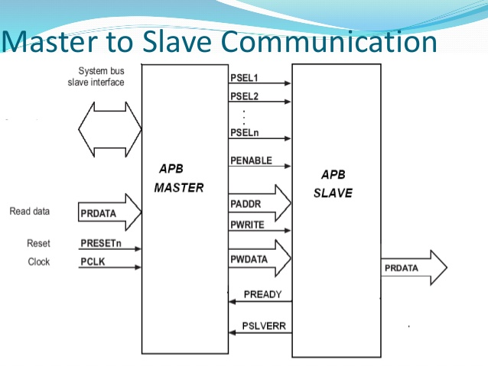
What's new ...???
This version (v1.0) includes:-
A ready signal, PREADY, to extend an APB transfer .
An error signal, PSLVERR, to indicate the failure of a transfer.

Slide 6
AMBA 3 APB Signals
Signals | Sources | Significance
PCLK | System Clock source | +ve edge matters in APB .
PADDR | APB bridge | 32 bit wide address bus
PSELx | APB bridge | For selecting the peripherals
PENABLE | APB bridge | Indicates 2nd cycle of APB transfer
PREADY | Slave interface | The slave uses this signal to extend an APB transfer.
PSLVERR | Slave interface | Used when any transfer failure occurs

Slide 7
AMBA 3 APB Signals Contd..
Signals | Sources | Significance
PWRITE | APB bridge | decides the nature of transfer .
PWDATA | APB bridge | 32 bit wide data bus
PRDATA | Slave interface | 32 bit wide bus ,active during read cycle

Slide 8
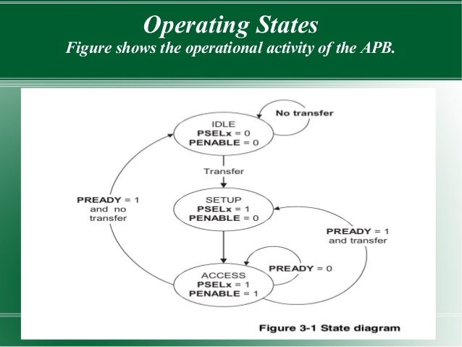
Operating States
IDLE State : Default state
SETUP : whenever any transfer required , PSELx = 1
ACCESS : PENABLE is asserted

Slide 9
Transfer Mechanism of APB
The AMBA 3 APB Protocol communicates with its peripherals by Reading and Writing the data . Basically two types of transfer operation occurs in APB .
1) Write Transfer
A) Write with NO wait state
B) Write with wait state
2) Read Transfer
A) Read with NO wait state
B) Read with wait state

Slide 10
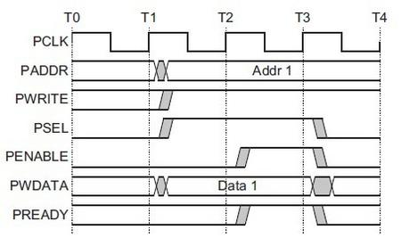
A) Write with NO wait state
The write transfer starts with the address, write data, write signal and select signal .
T1 - Setup Phase , PSEL = High
T2-Access Phase ,PENABLE = High
The address, data and control signals all remain valid throughout the Access phase.
The transfer completes at the end of this cycle.

Slide 11
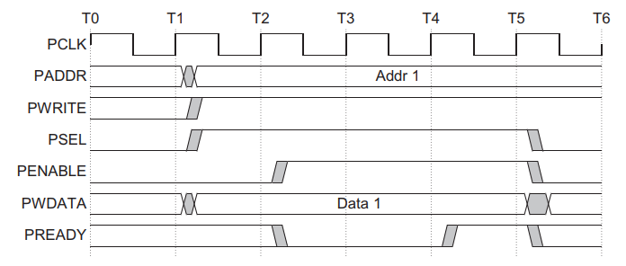
B) Write with wait state
During an Access phase, when PENABLE is HIGH, the transfer can be extended by driving PREADY LOW.
The following signals remain unchanged for the additional cycles:
[ PADDR , PWRITE , PSEL, PENABLE ,PWDATA ]
[ Imposes wait ]

Slide 12
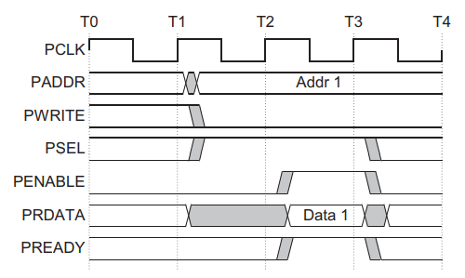
A) Read with NO wait state
The slave must provide the data before the end of the read transfer.
PREADY = HIGH ,during the Access Phase

Slide 13
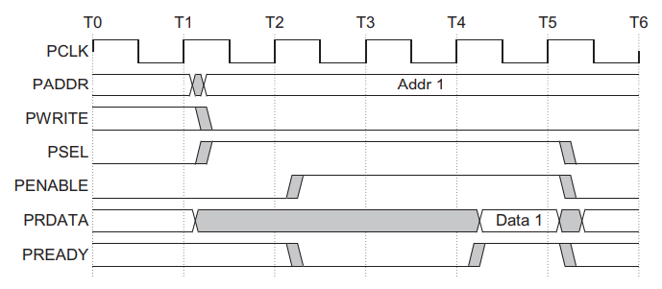
B) Read with wait state
The following signals remain unchanged for the additional cycles : [ PADDR , PWRITE , PSEL, PENABLE ,PRDATA ]
PREADY = LOW , during the Access Phase causes wait .
[ Imposes wait ]

Slide 14
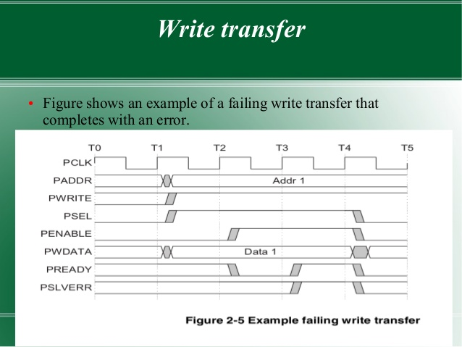
Error Response
You can use PSLVERR to indicate an error condition on an APB transfer. Error conditions can occur on both read and write transactions.
PSLVERR is only considered valid during the last cycle of an APB transfer, when PSEL, PENABLE, and PREADY are all HIGH .
APB peripherals are not required to support the PSLVERR pin. This is true for both existing and new APB peripheral designs. Where a peripheral does not include this pin then the appropriate input to the APB bridge is tied LOW.

Slide 15
Conclusion
Though AMBA 3 APB comes up with additional signal like PSLVERR , all peripherals may not necessarily support this PIN .
Where a peripheral does not include this pin then the appropriate input to the APB bridge is kept grounded .
When compared to AHB ,the APB is only used for low Bandwidth controll accesss .
Though APB has an address and data phase as like that of AHB , it comes with a list of low complexity signal .

